Slide 1

👻 Grant Ghost
Stop Leaving Money on the Table
$1.1T in Unclaimed Grants
AI-powered grant discovery designed for rural America. Hyper-local matching. 92%+ accuracy. 1–4 alerts per month.
[Your Name], Founder
Bossier City, Louisiana
Pitch Deck | January 2026

Slide 2
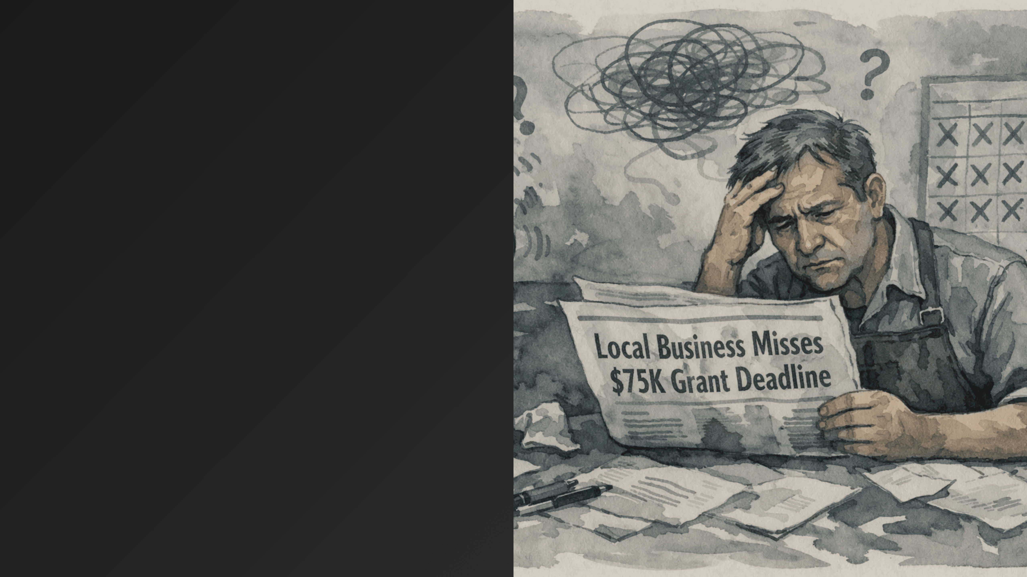
$1.1 Trillion Left on the Table
67%
Rural businesses miss grants due to broken discovery system
Grants.gov has 67% abandonment rate—overwhelming noise, poor UX
▪
Competitors cost $99–$499/mo, designed for urban grant professionals
▪
5.8M small businesses + 1.1M nonprofits in rural America underserved
▪
Average $50k grant pays for 25 years of subscription—but you miss it
▪

Slide 3

Hyper-Local Alerts + Ruthless Filtering
Hyper-local ZIP+NAICS matching (no irrelevant noise)
✓
Only alerts for ≤21 day deadlines + $10k+ funding
✓
92%+ match confidence on every alert
✓
1–4 alerts per month (not 500+)
✓
Email, SMS, or dashboard delivery
✓
Pricing
$39
$79
/mo Starter
/mo Pro

Slide 4

Massive Underserved Market
Total Addressable Market (TAM)
$1.1T
Annual federal, state, and local grants disbursed in the U.S.
Serviceable Addressable Market (SAM)
$150–400M
Subscription market for rural grant discovery tools
Serviceable Obtainable Market (SOM) – Year 1
$5–15M
Conservative: 5,000 customers × $54 ARPU × 12 months
5.8M small businesses in rural America
●
1.1M nonprofits in underserved regions
●
18,000 fire departments + 10,000 municipalities
●
Current penetration: <1%
●

Slide 5

Grant Ghost Wins: 20–50% Cheaper with Superior Rural Matching
Competitor
Price
Target
Positioning
Weakness
$99–$499/mo
Grant professionals
Comprehensive database + CRM
Too expensive; urban-focused
Instrumentl
$49–$199/mo
Nonprofits + SMBs
Broad database + email alerts
Generic results; high noise; poor rural matching
GrantWatch
$79–$299/mo
Early-stage startups
AI-powered matching
Early stage; limited coverage; no rural focus
OpenGrants
Free
Anyone
Official government source
67% abandonment; overwhelming noise; poor UX
Grants.gov
$39–$79/mo
Rural SMBs + nonprofits
Hyper-local + ruthless filtering
Grant Ghost
Lowest price + highest relevance
For a rural business owner, Grant Ghost is a no-brainer: 20–50% cheaper than competitors with superior rural matching and 92%+ relevance. One $50k grant pays for 25 years of subscription.

Slide 6
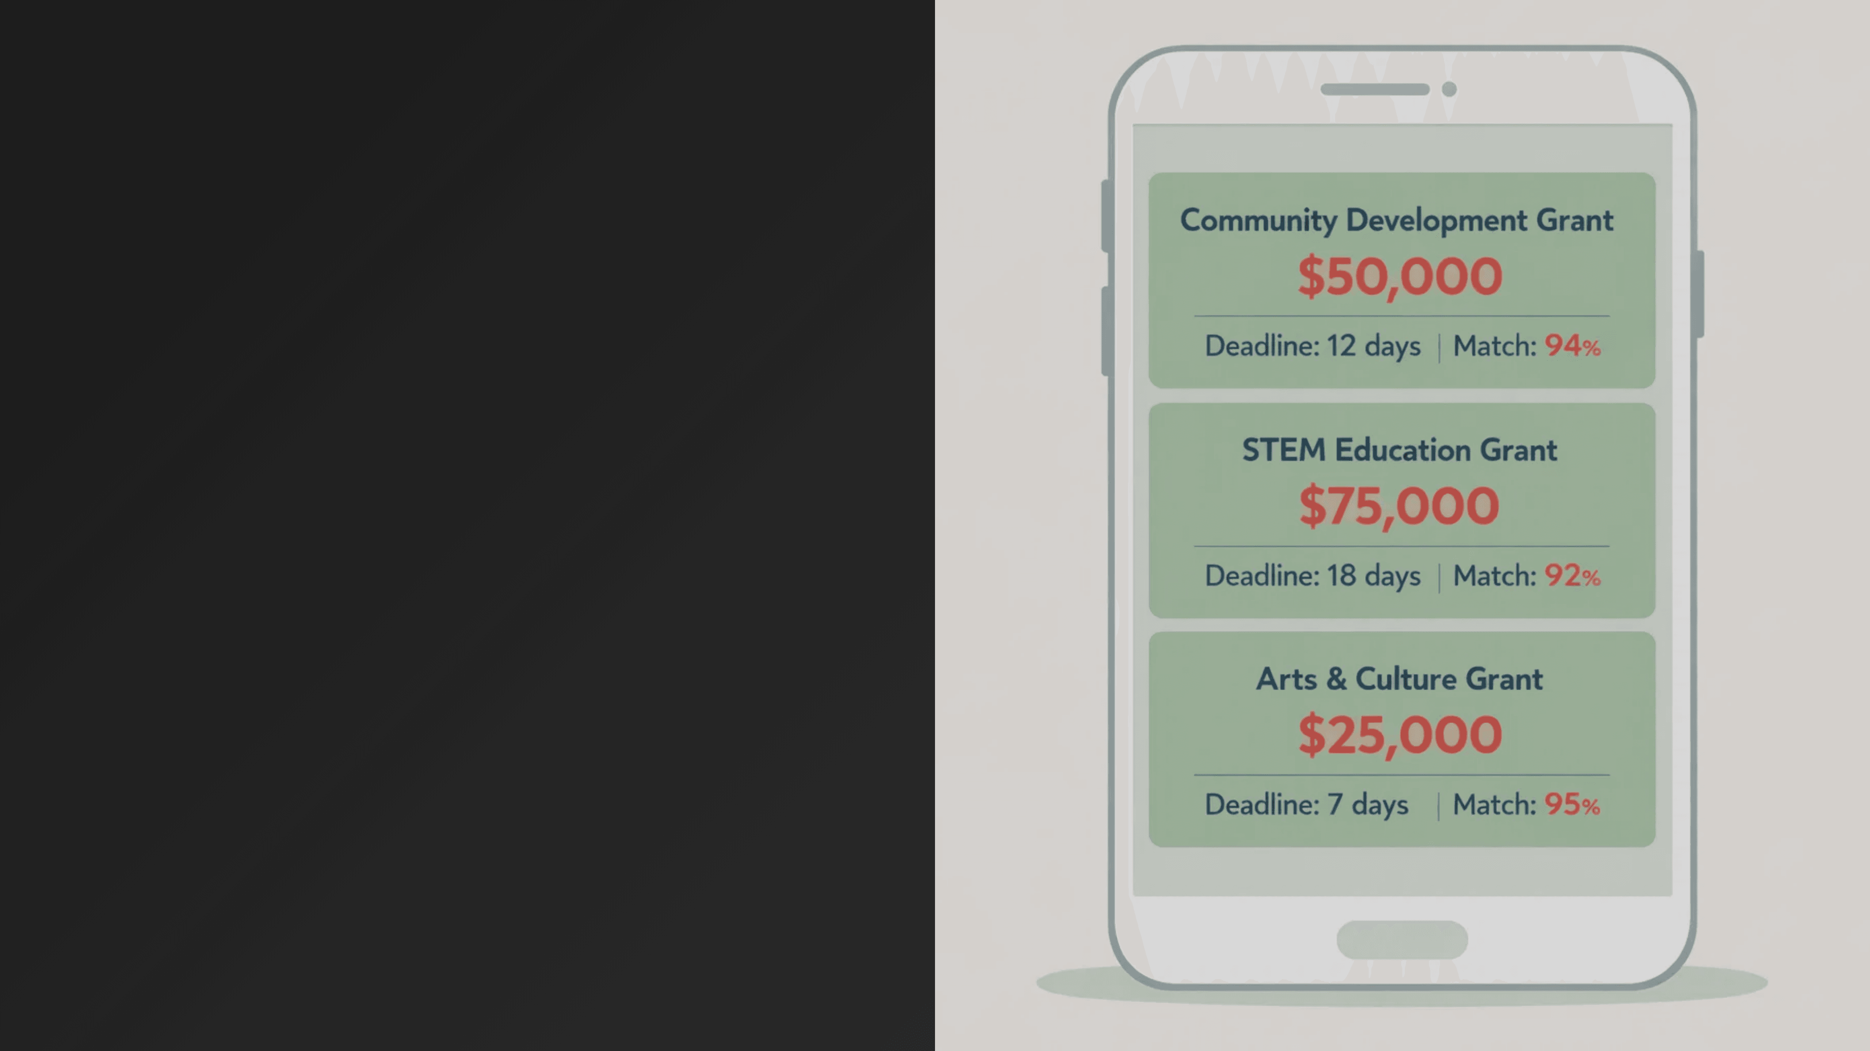
Four Layers of Competitive Advantage
1
Hyper-Local Data Integration
ZIP+NAICS matching requires 6+ months of data integration. Competitors use state-level filtering only.
2
Ruthless Deadline-First Filtering
Only ≤21 day deadlines + $10k+ funding. Eliminates decision fatigue. 40% higher application completion.
3
White-Label Chamber Partnerships
500+ rural Chambers = 100k potential customers. Network effects + relationships. Distribution moat.
4
Missed Grants Audit (Proprietary)
Retroactive 24-month analysis. "You missed $247k." Converts 25–30% of trial users to paid. Proprietary.
18–24 month head start. Competitors cannot replicate this combination quickly.

Slide 7

Venture-Scale Unit Economics
35.8:1 LTV:CAC + 1.2-Month Payback
$67
$2,399
35.8:1
1.2mo
85%
Customer Acquisition Cost
Lifetime Value
LTV:CAC Ratio
Payback Period
Gross Margin
Grant Ghost vs. Industry Benchmark
Metric
Grant Ghost
Industry Benchmark
Advantage
CAC
$67
$150–$300
2–4x better
LTV:CAC Ratio
35.8:1
3:1 (healthy)
12x better
Payback Period
1.2 months
12 months
10x faster
Gross Margin
85%
70–80%
Above average
For every $1 spent on customer acquisition, Grant Ghost generates $35.80 in lifetime value. Payback happens in 5 weeks. This is venture-scale unit economics.

Slide 8

Three Revenue Streams Reduce Risk
Subscriptions (70%) + Audits (20%) + Chamber Partnerships (10%)
Subscriptions
Missed Grants Audit
Chamber Partnerships
Starter: $39/mo (60% of subscribers) Pro: $79/mo (40% of subscribers) Blended ARPU: $54/mo
Price: $199 one-time Conversion: 20–35% of customers Amortized: $52 per customer
Per Chamber: $500–$2k/mo Rev-Share: 30% of subscriptions Target: 50 Chambers by M18
70%
20%
10%
of Total Revenue
of Total Revenue
of Total Revenue
Year 1 Total Revenue
Key Insight
$1.8–2.5M
No single revenue stream exceeds 70%. If one underperforms, others compensate. This diversification reduces risk and maximizes lifetime value per customer.
Subscriptions: $1.2–1.6M Audits: $360k–500k Chambers: $240k–400k

Slide 9

Path to Scale: Three Phases to $3M ARR
1
Founder-Led Sales
2
Chamber Partnerships
3
Paid Acquisition
Timeline:
Months 1–3
Timeline:
Months 4–9
Timeline:
Months 10–18
Target:
50–100 customers
Target:
20 Chamber partnerships
Target:
5,000 customers
Method:
Cold email, Facebook ads, networking
Method:
Direct outreach + case studies
Method:
Facebook ads, content marketing, Chambers
CAC:
$8–$12
CAC:
$2–$4
CAC:
$12–$15
Goal: Prove product-market fit, gather testimonials
Goal: Reach 5,000+ potential customers through Chamber networks
Goal: Prove venture-scale growth, reach $3M+ ARR
Customer Growth Trajectory
Phase 1 End
Phase 2 End
Phase 3 End
100
→
500
→
5,000
Month 3
Month 9
Month 18

Slide 10
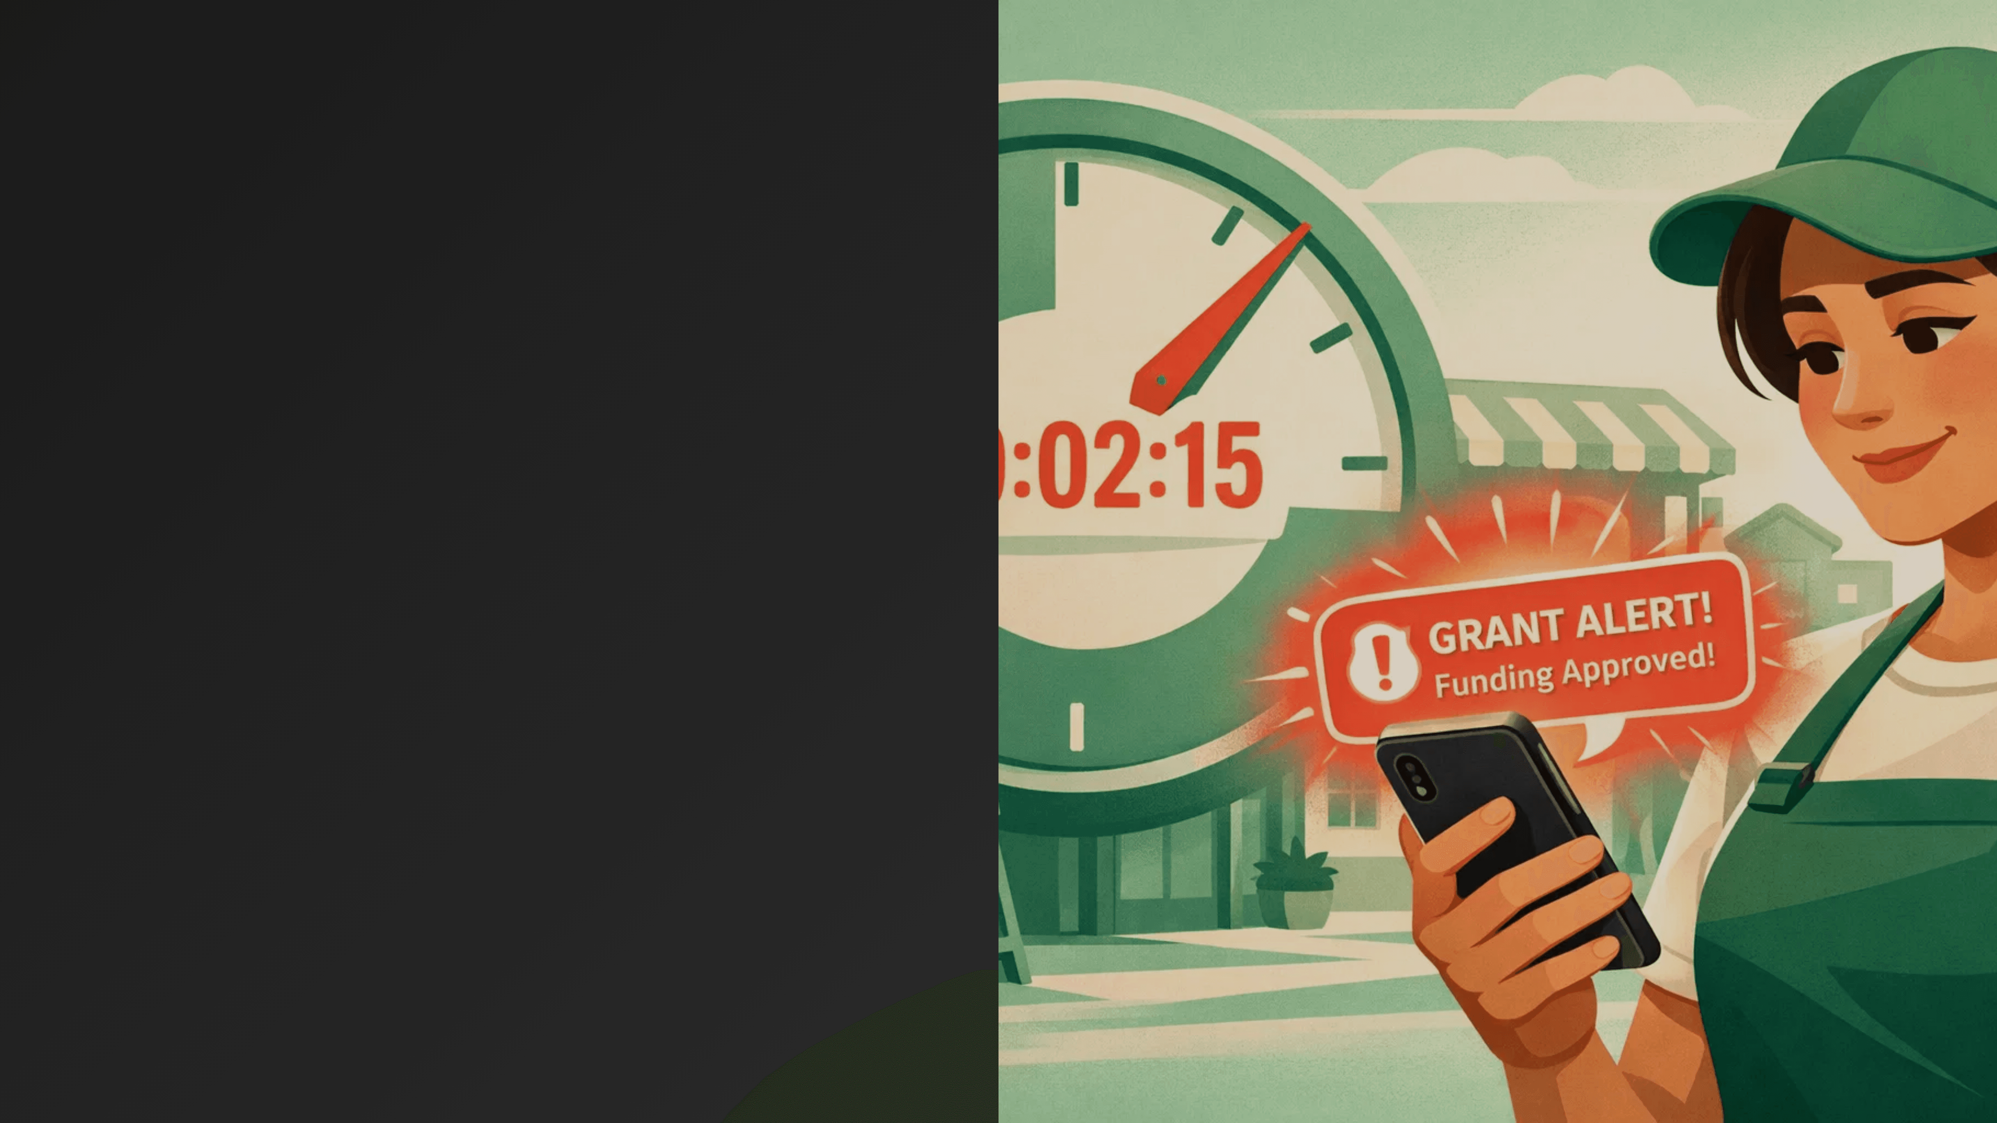
Real Traction: Proven Product-Market Fit
18%
Trial-to-Paid Conversion (Industry avg: 12–15%)
"I got one alert per month. Applied to three. Got funded twice. $85k total."
Mike – Tire Shop Owner, Bossier City, LA
"The Missed Grants Audit showed we qualified for $340k in grants we never knew about."
Jennifer – Food Bank Director, Texas
97%
Monthly Retention (Industry avg: 93–95%)

Slide 11

Rural Founder + Experienced Advisors + Lean Team
Founder
Advisors
[Your Name]
Advisor #1: [Name]
Founder & CEO
Grant industry expertise; former director at major grant orgs.
Background: 10+ years in rural business/grant ecosystem
Advisor #2: [Name]
Location: Bossier City, LA
SaaS scaling expert; B2B growth & unit economics.
Key Strength: Market knowledge + founder-led sales
Advisor #3: [Name]
Rural business development; deep local relationships.
2
2
Full-Stack Engineers
Sales & Ops
AI/ML matching + data
Chamber outreach + support
Execution Timeline
M1–2
M3
M6
M12
M18
Build AI engine + data integrations
MVP launch + 50 customers
500 customers + 10 Chambers
2,500 customers
5,000 customers + $3M ARR
We're not hiring 50 people. Lean, focused hires to execute quickly.

Slide 12

The Ask
$500K Seed
Use of Funds
18-Month Milestones
AI/ML Engineering: $150k
Month 3
100 customers / $5k MRR
Data Integration: $100k
Chamber Infrastructure: $75k
Month 6
500 customers / $27k MRR
Sales + Marketing: $100k
Month 12
2,500 customers / $135k MRR
Operations + Legal: $50k
Runway (6 months): $25k
Month 18
5,000 customers / $270k MRR
Exit Potential
Strategic Acquisition
IPO Path
$50–100M
$500M+
Stripe, Square, or Shopify (3–5 years)
If reaching $50M+ ARR (5–7 years)
$500k seed at $5M post-money valuation (10% equity) = 10–20x return in 3–5 years

